Slide 1
Haematological Malignancy Research Network
February 2021

Slide 2
UK cancer registrations
Office for National Statistics: Cancer registration statistics, England (2017)
Public Health Scotland: Cancer incidence and prevalence in Scotland (to December 2017)
Public Health Wales: Cancer incidence in Wales, 2001-2017

Slide 3
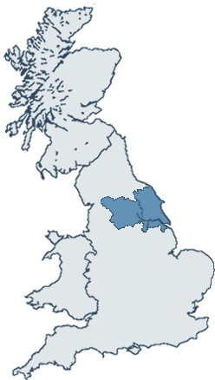
HMRN study region
Population 3.6 million
Similar socio-demographic structure to UK
Age
Sex
Affluence/deprivation
Urban/rural status
Office for National Statistics (2011) Census: Standard Area Statistics (England, Scotland, Northern Ireland)

Slide 4
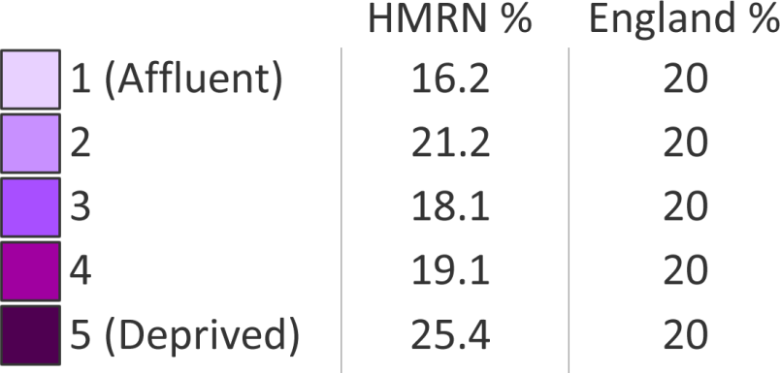
Index of multiple deprivation: income domain

Slide 5
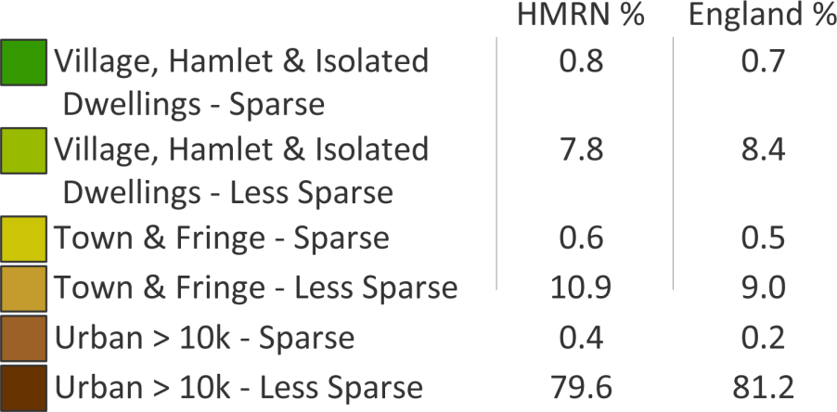
Office for National Statistics (ONS): rural/urban definition

Slide 6
HMRN organisation
Clinical care
Haematology clinical teams
Yorkshire Cancer Network
Humber & Yorkshire Coast Cancer Network
Data management & analysis
Epidemiology & Cancer Statistics Group (ECSG)
Health Sciences
University of York
Diagnostics
Haematological Malignancy Diagnostic Service (HMDS)
St James’s Institute of Oncology
Leeds Teaching Hospitals NHS Trust

Slide 7
Summary of routine data sources and analysis
Diagnostics
Demographics
Prognostics
Treatment
Death certificates & Cancer registrations
Follow-up
Descriptive epidemiology
Survival & prognostics
Aetiology
Patient pathway
Health economics
Audit

Slide 8
HMRN data
Histology, cytology, immunophenotyping, molecular cytogenetics, mutational analysis, flow cytometry, gene expression profiling, disease progressions & transformations
Antecedent & concurrent events, route to diagnosis, blood count, performance status (ECOG), stage, treatment and response
Patient characteristics, symptoms, events leading to diagnosis, quality of life, experience
Deaths, cancer registrations, Hospital Episode Statistics, measures of socioeconomic deprivation, urban/rural status

Slide 9
Using HMRN data Improving patient care through analysis of the patient pathway

Slide 10
Incidence

Slide 11
HMRN annual incidence rates (per 100,000)

Slide 12
Incidence of haematological malignancy subtypes varies with age…

Slide 13
…but not social class

Slide 14
Patient pathway: follicular lymphoma to diffuse large B-cell lymphoma transformation

Slide 15
The problem with clinical trials AML 2004-2017

